Slide 1

GEOG 4/590: Geospatial Data Science
Lecture 3: Network data analysis
Email: jryan4@uoregon.edu
Office: 163A Condon Hall
Office hours: Monday 15:00-16:00 and Tuesday 14:00-15:00

Slide 2
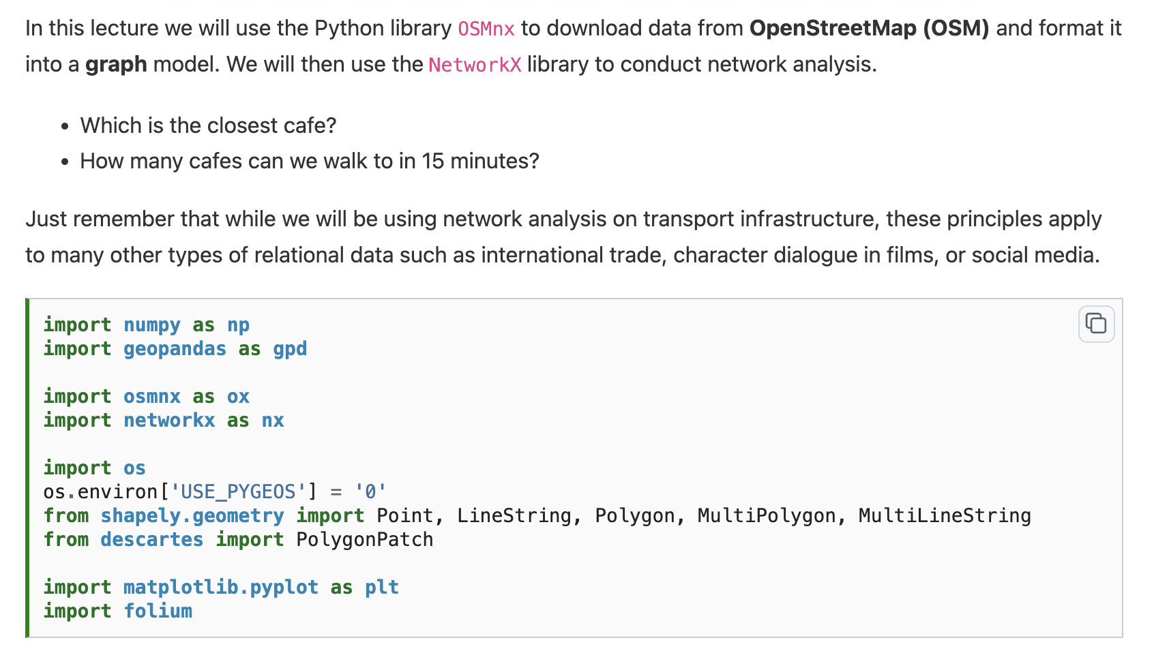

Slide 4
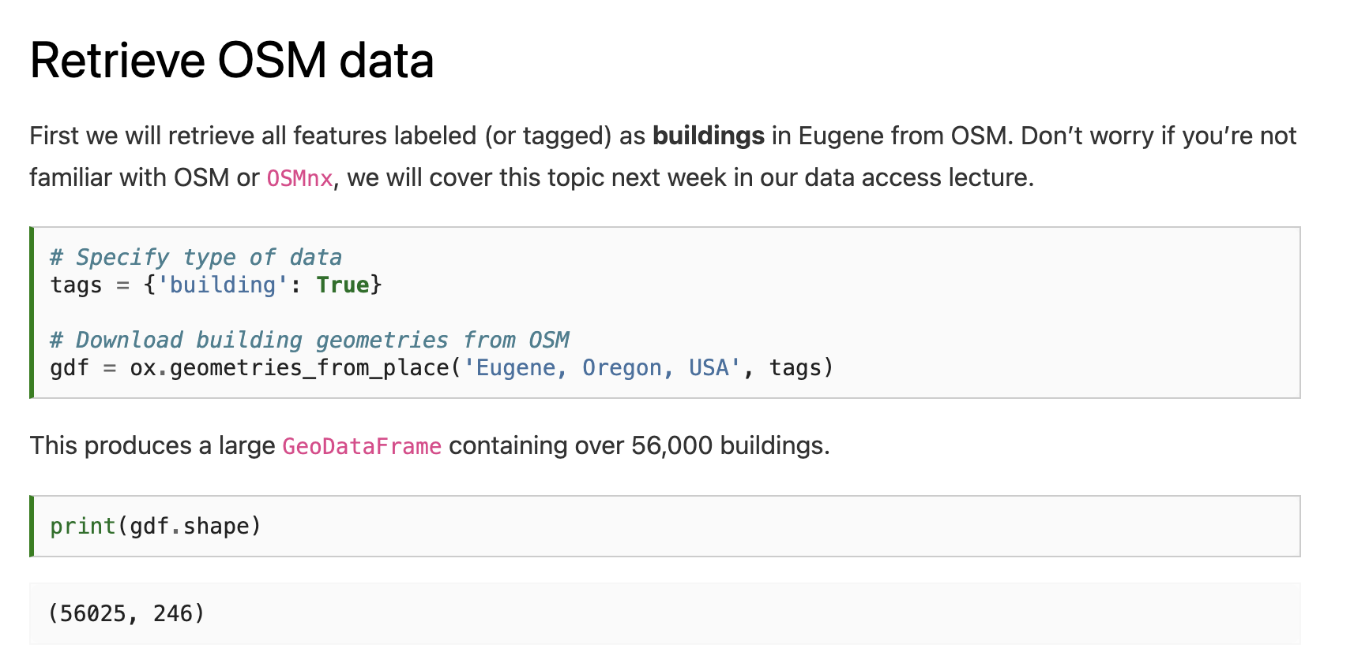

Slide 6
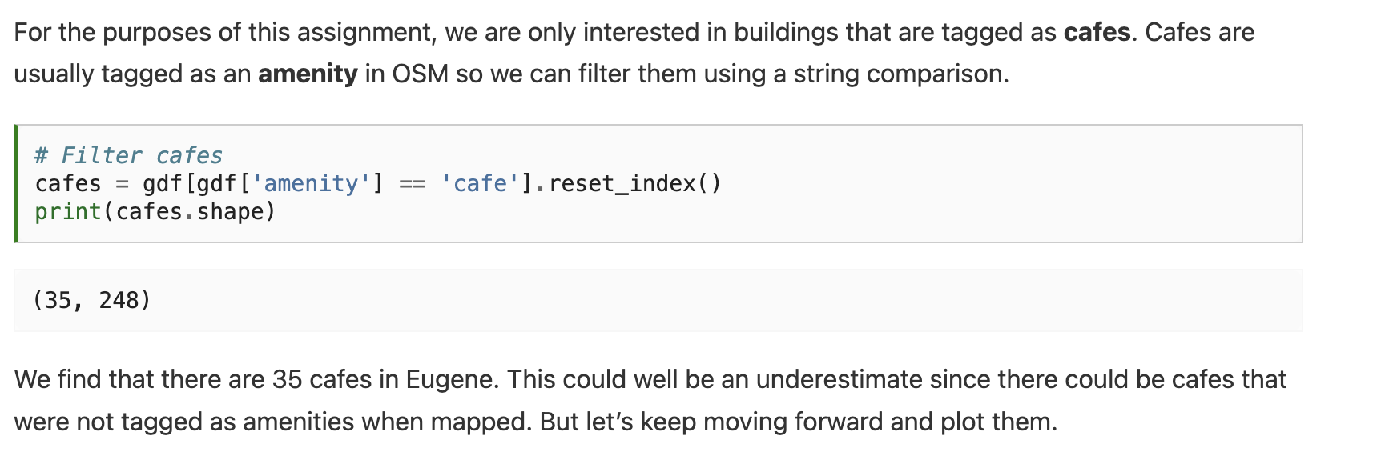

Slide 7
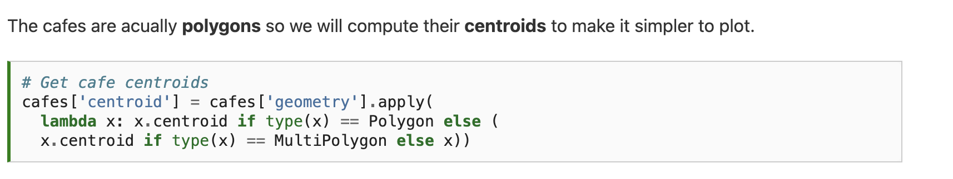

Slide 8
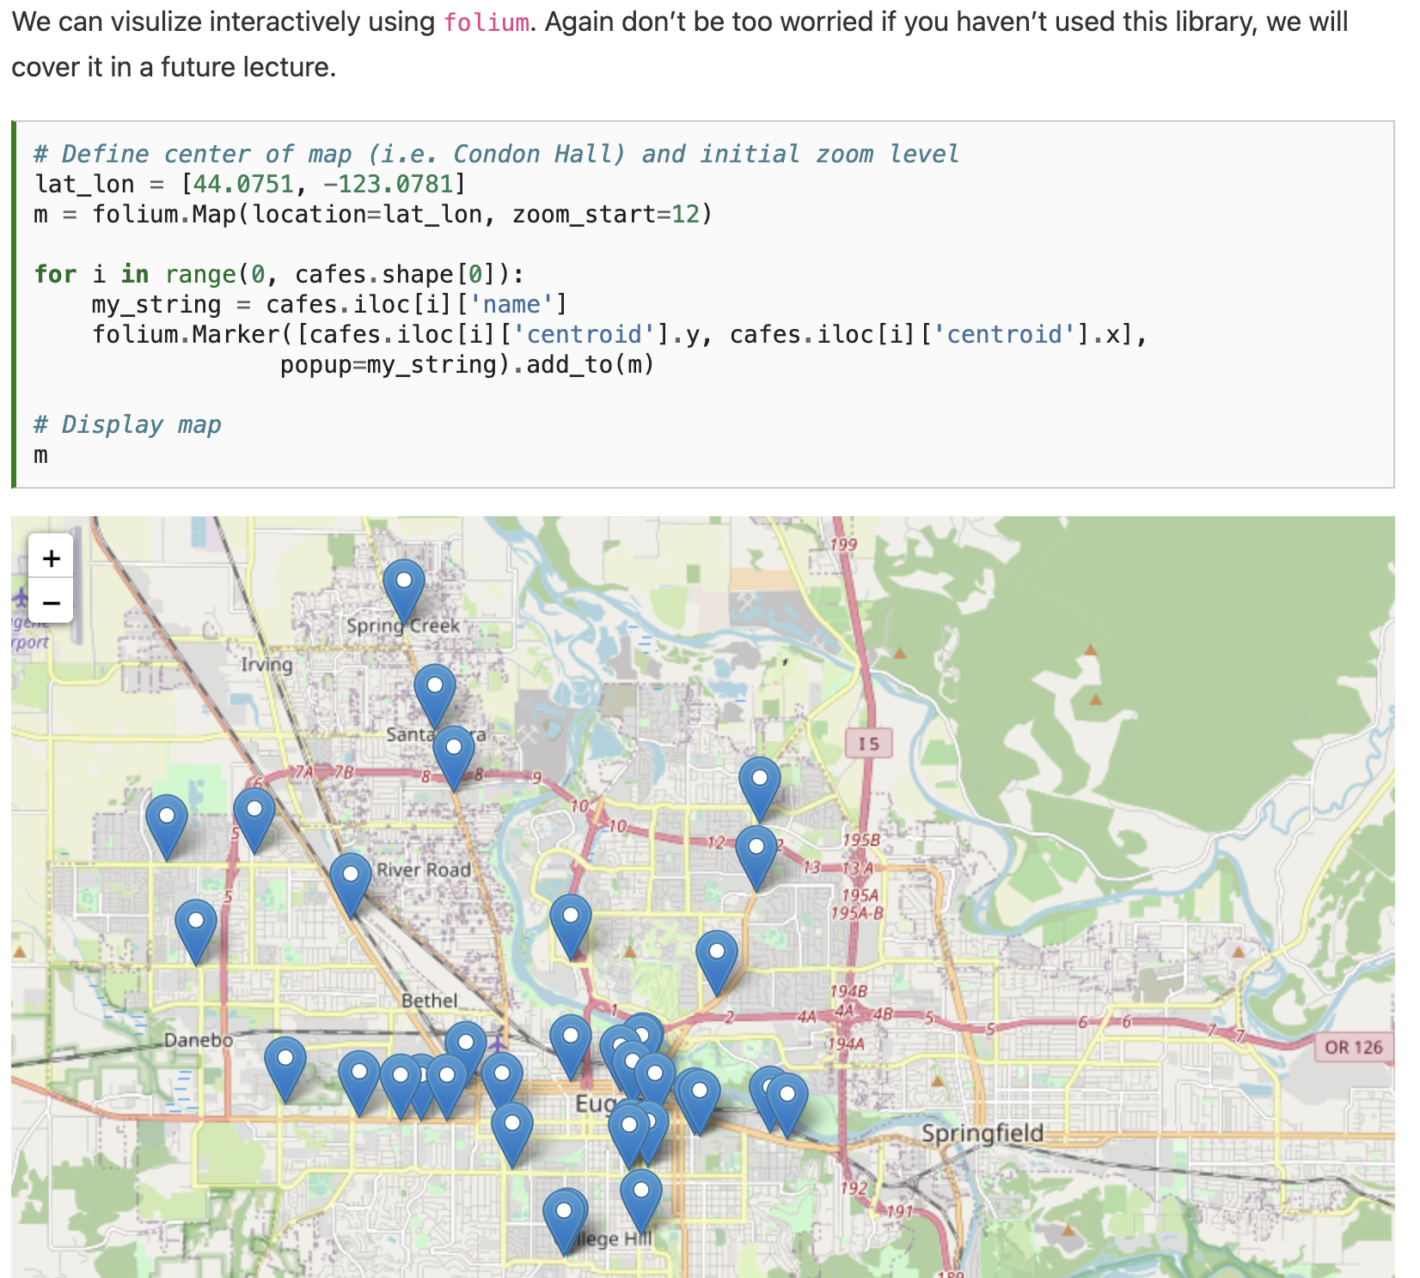

Slide 9
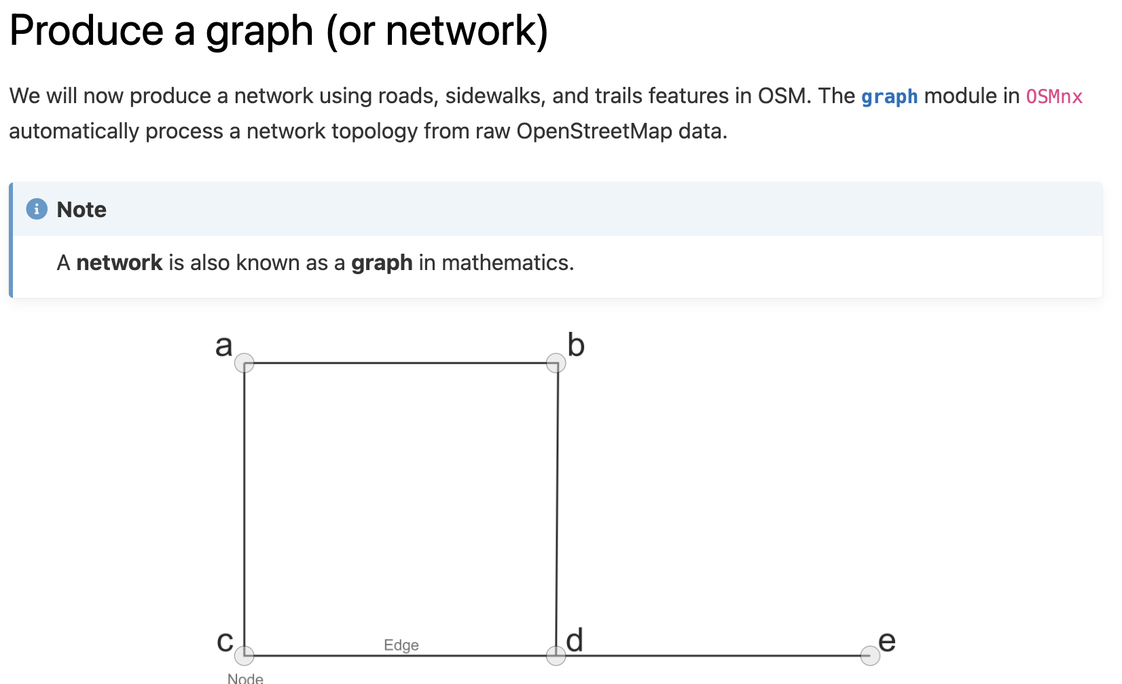

Slide 10
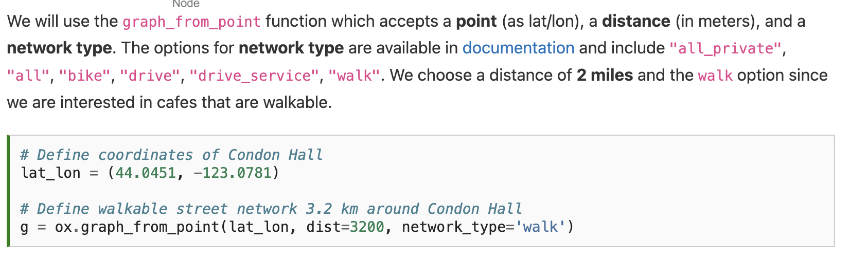

Slide 11
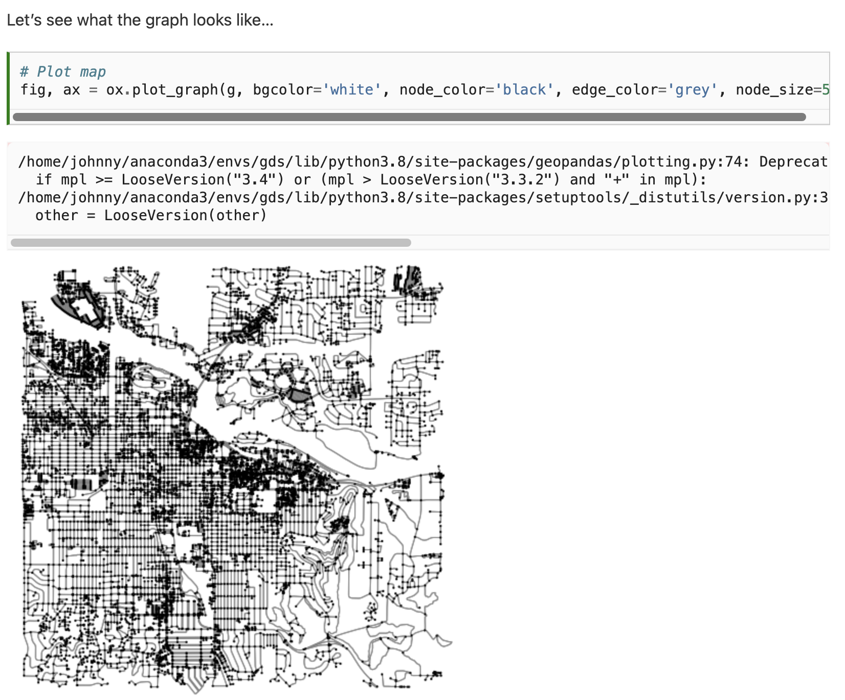

Slide 12
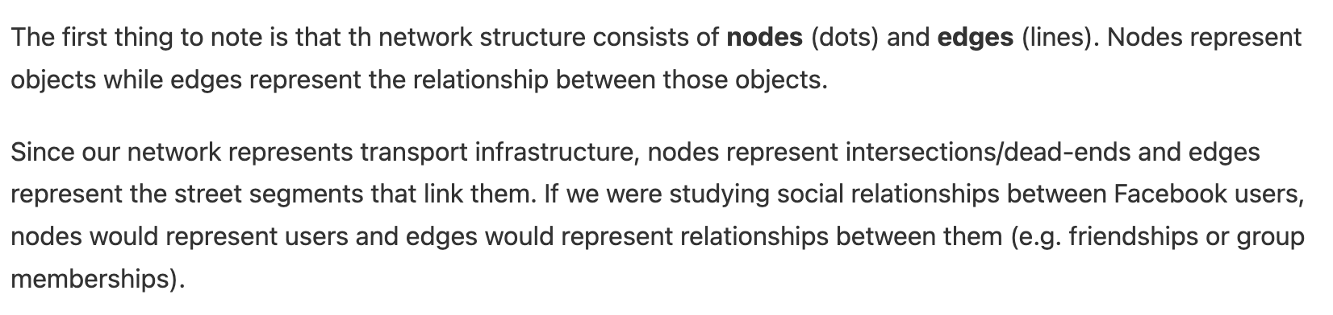
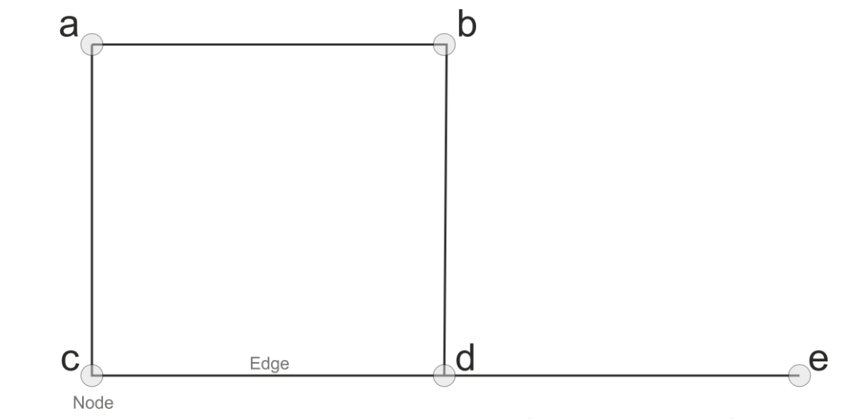

Slide 13
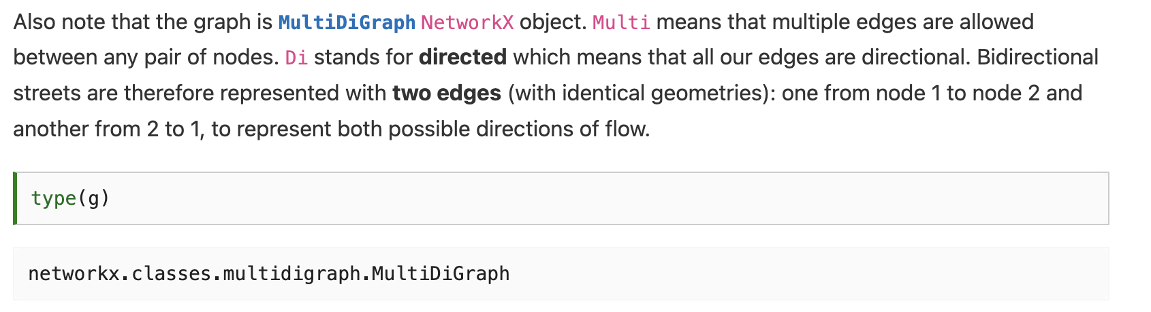

Slide 14
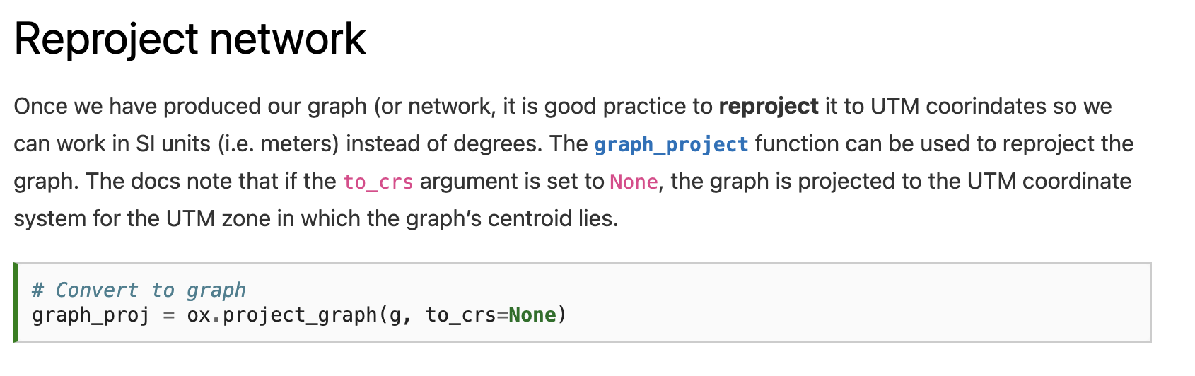

Slide 15
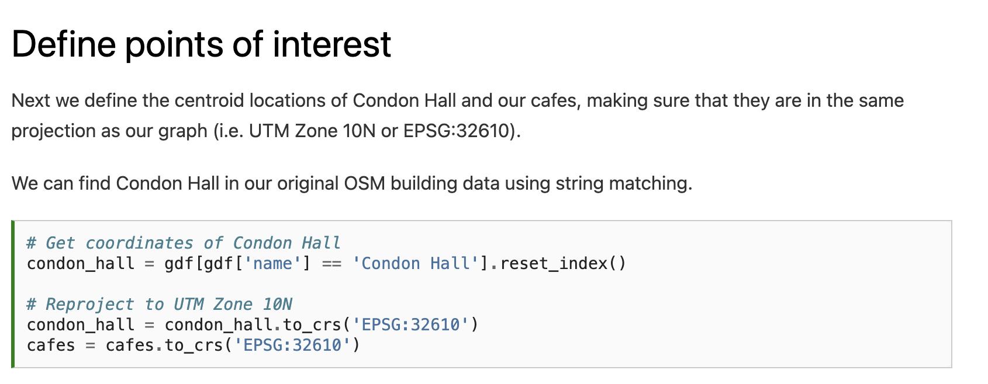

Slide 17
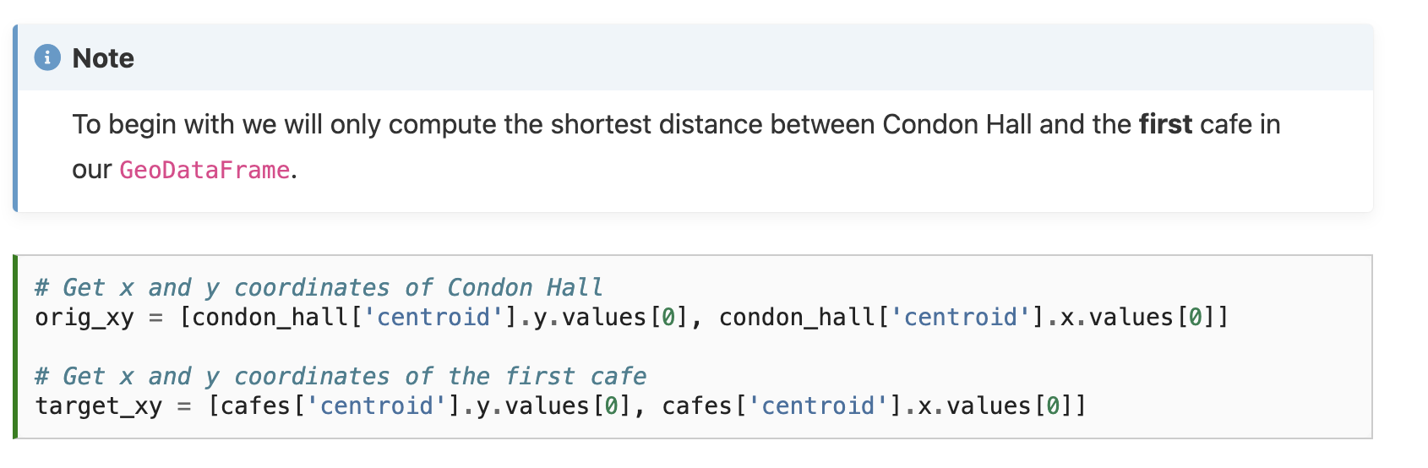

Slide 18
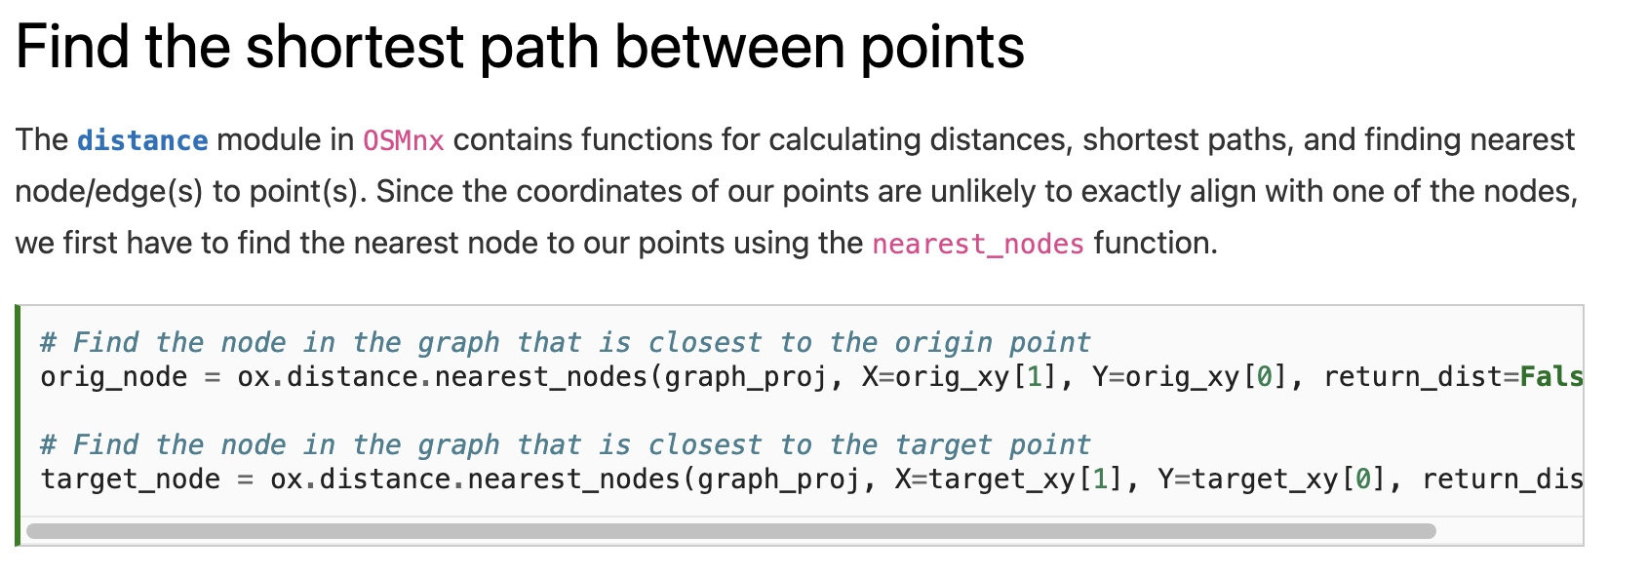

Slide 19
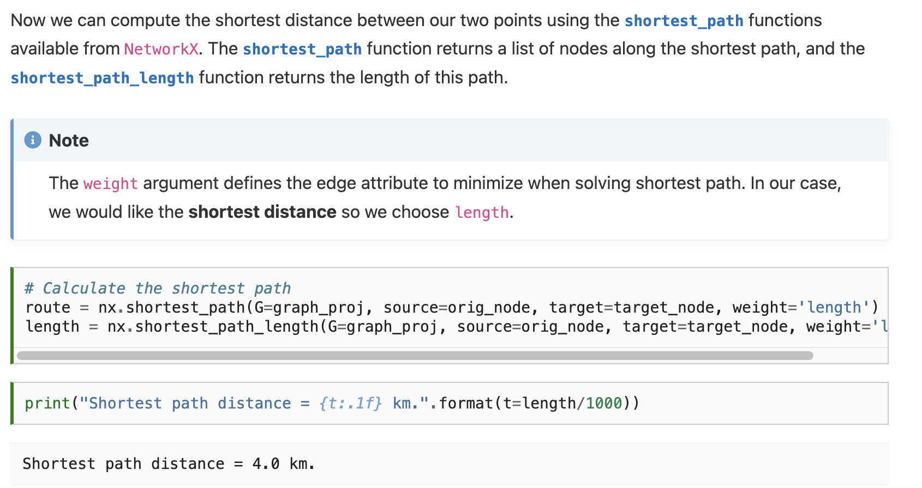

Slide 22
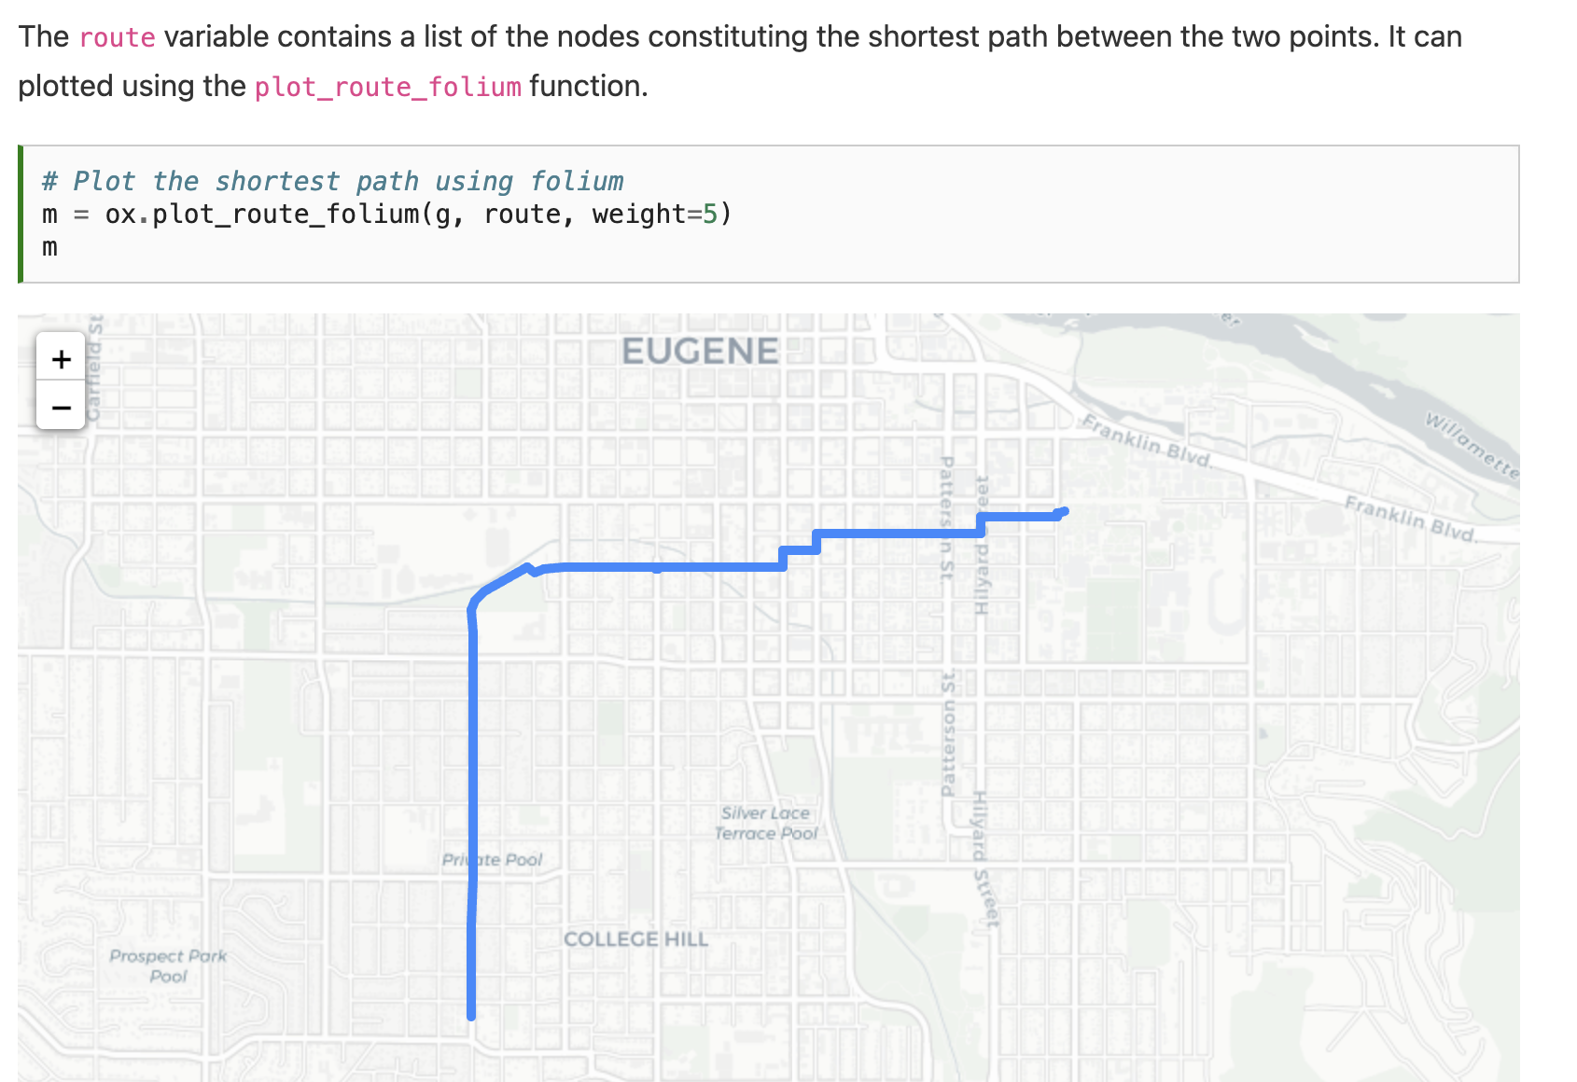

Slide 23
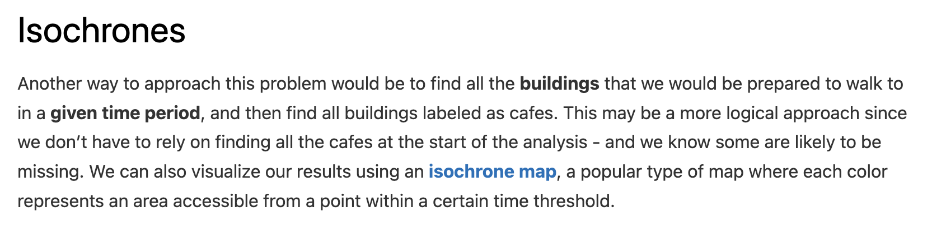

Slide 24
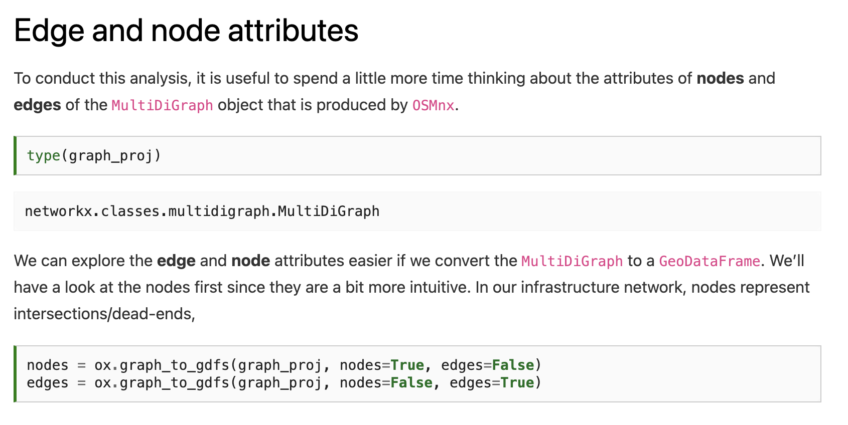

Slide 26
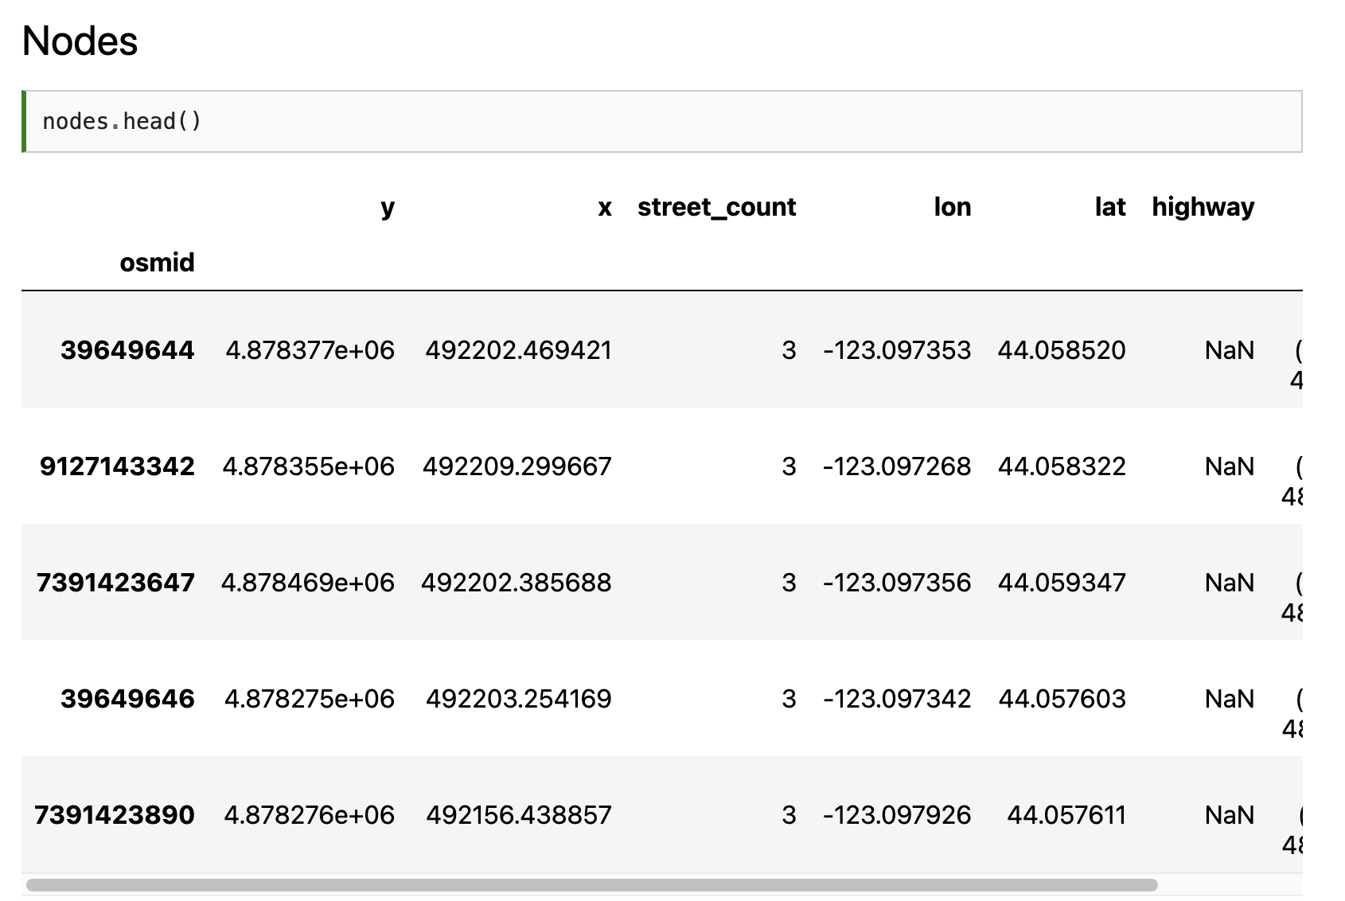
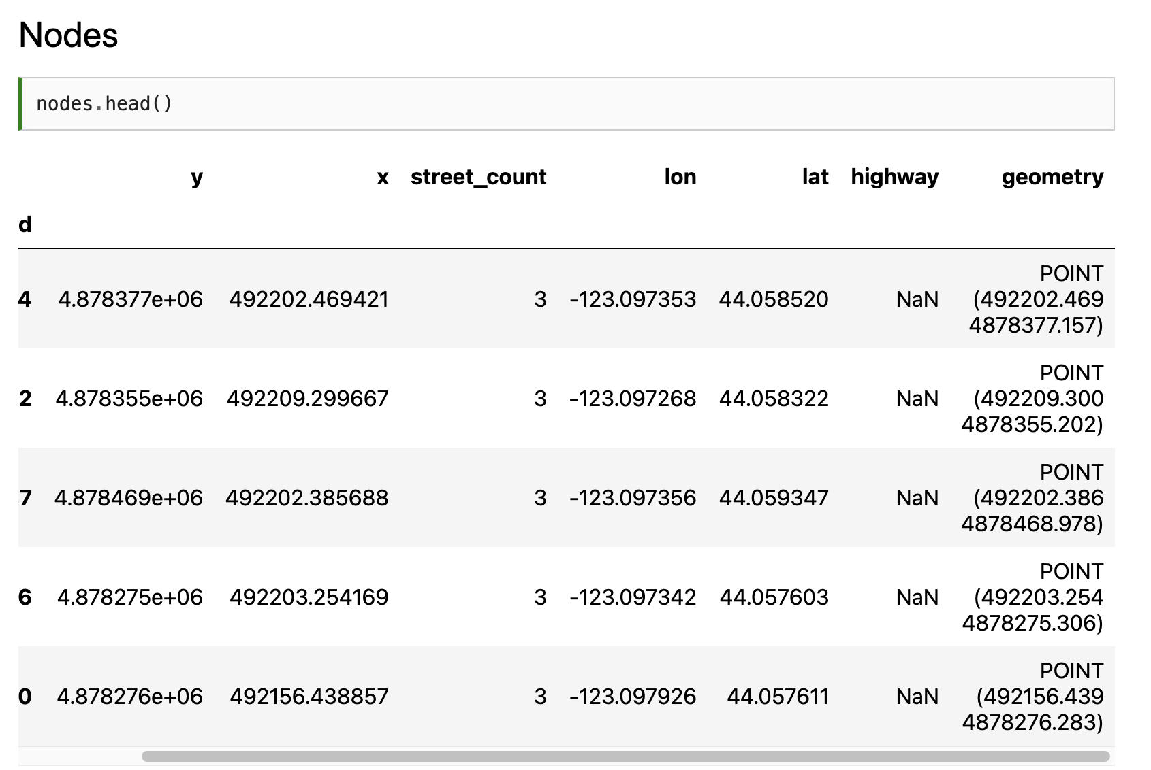

Slide 27
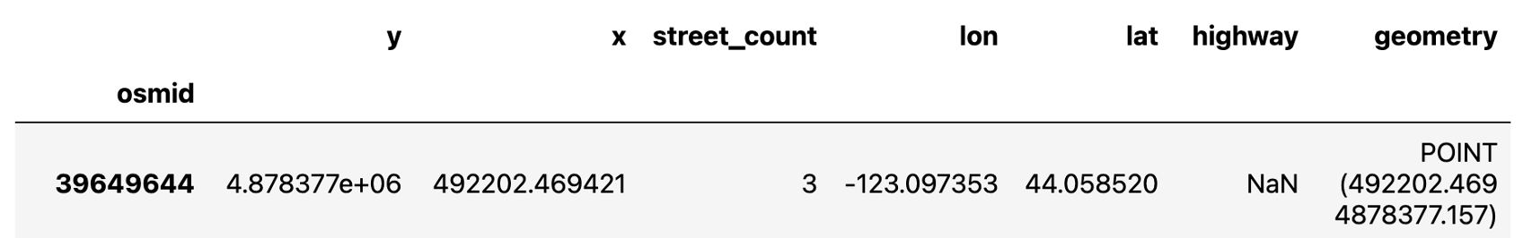
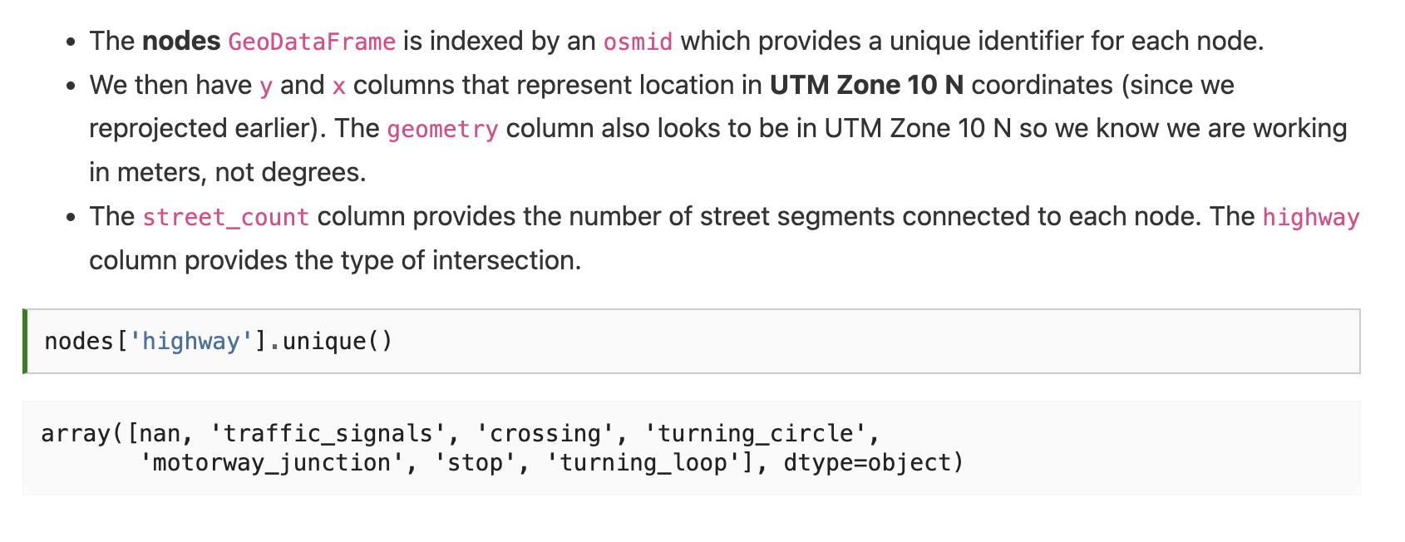

Slide 29
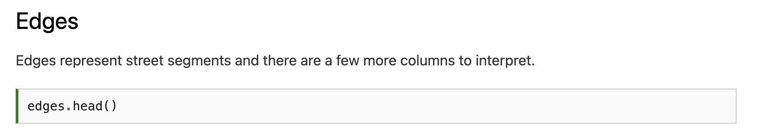
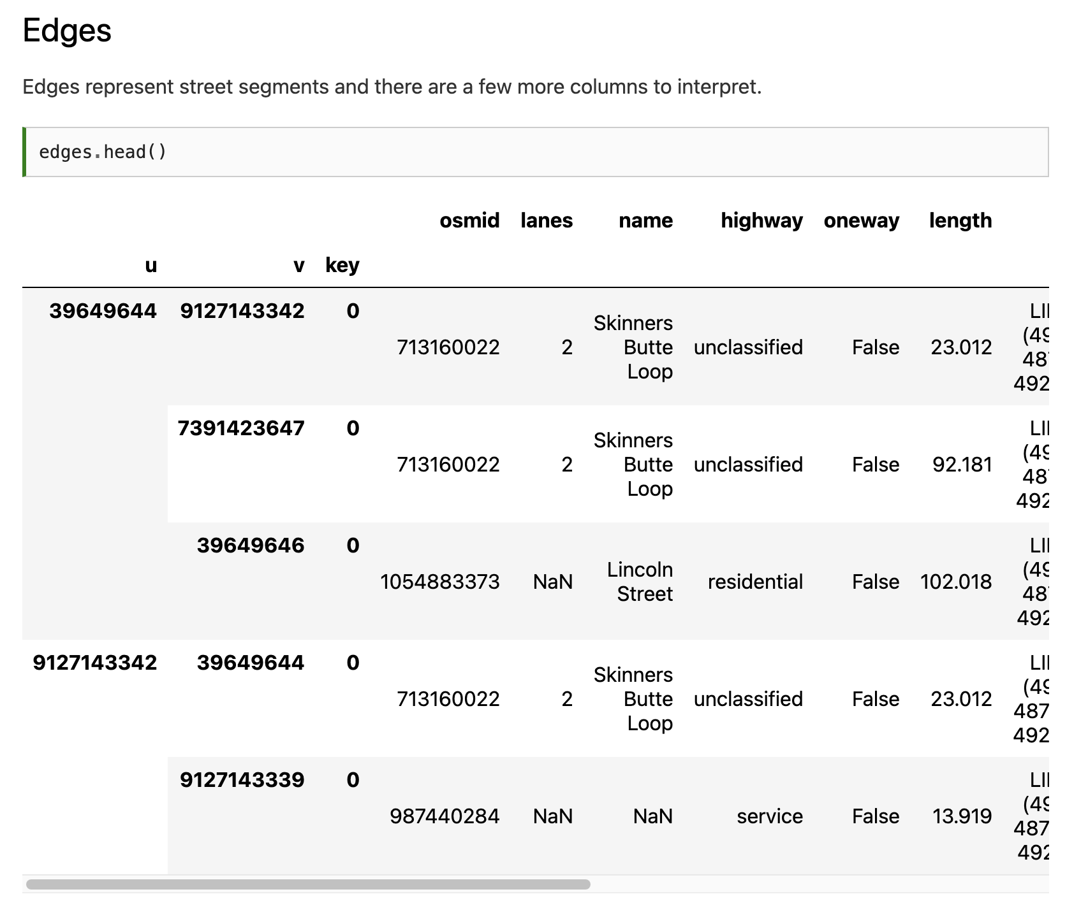
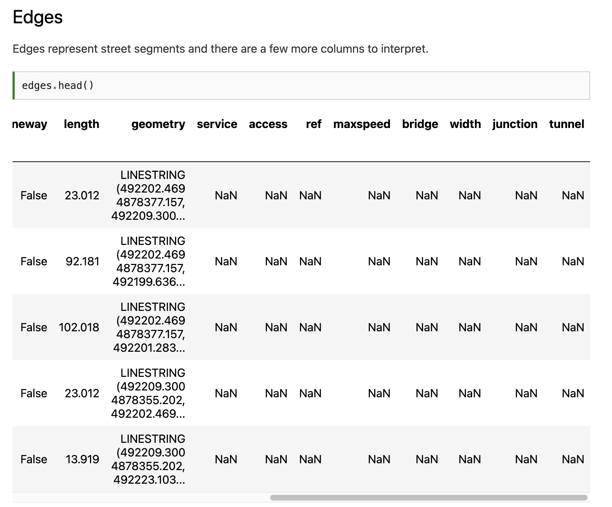

Slide 30
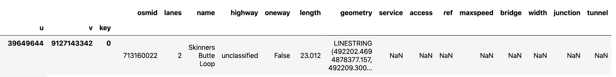
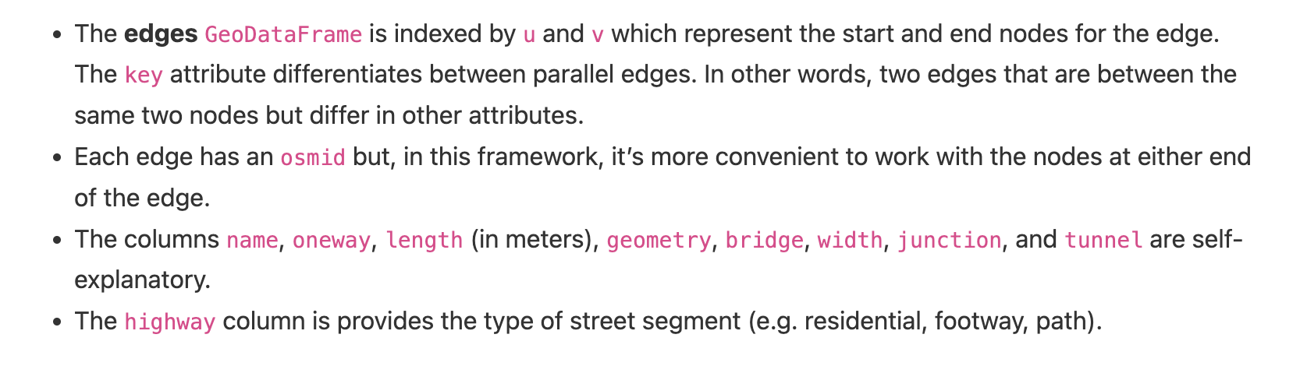

Slide 31
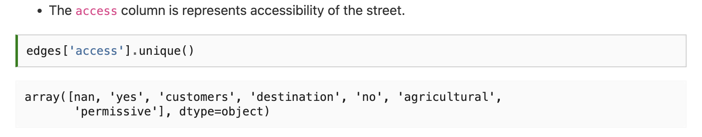

Slide 32
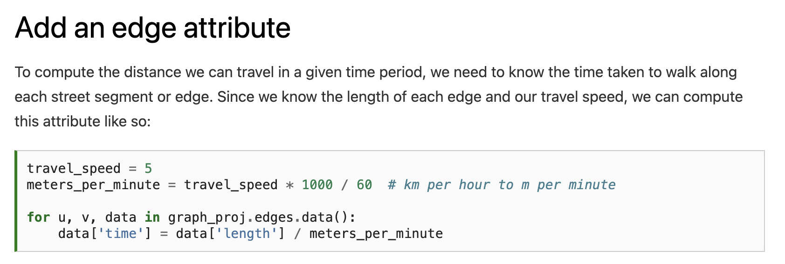

Slide 33
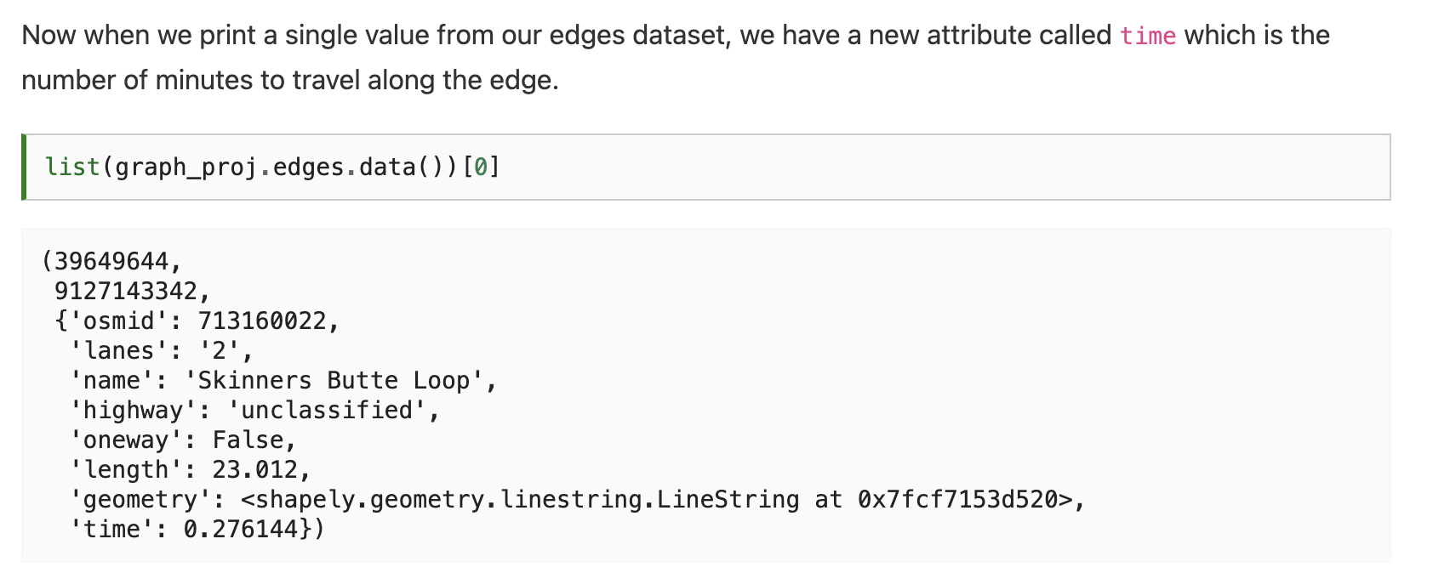

Slide 34
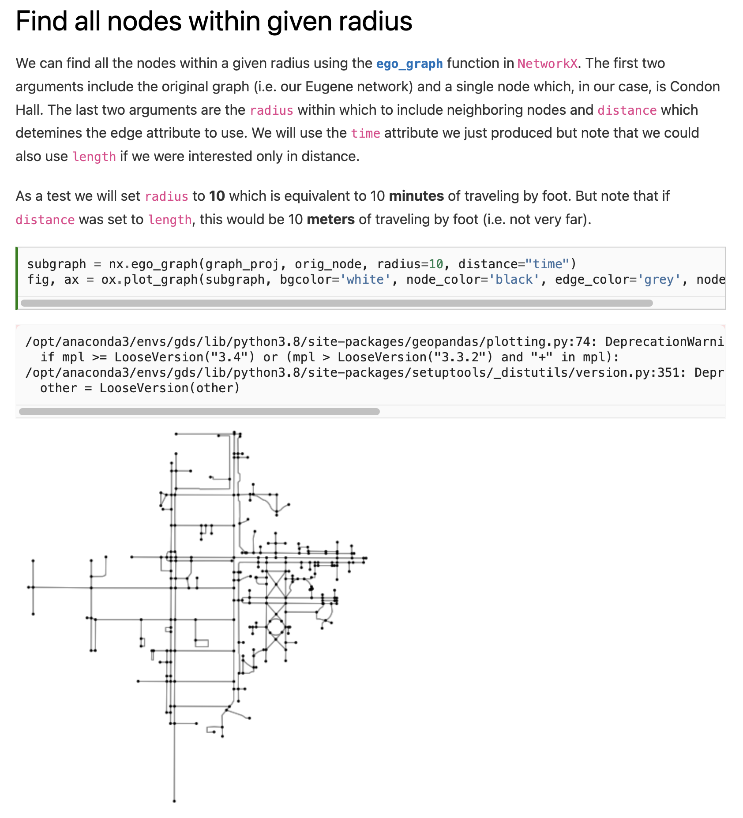

Slide 36
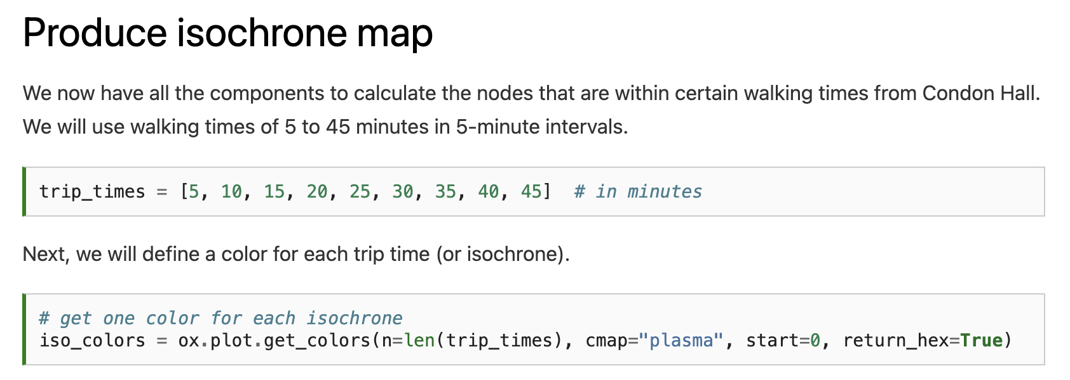

Slide 37
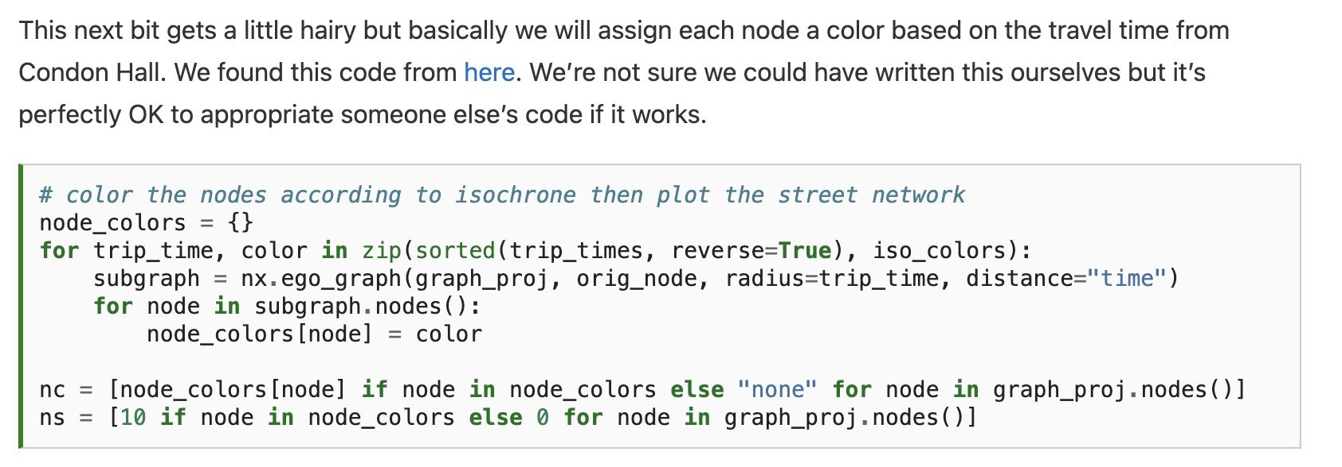

Slide 38
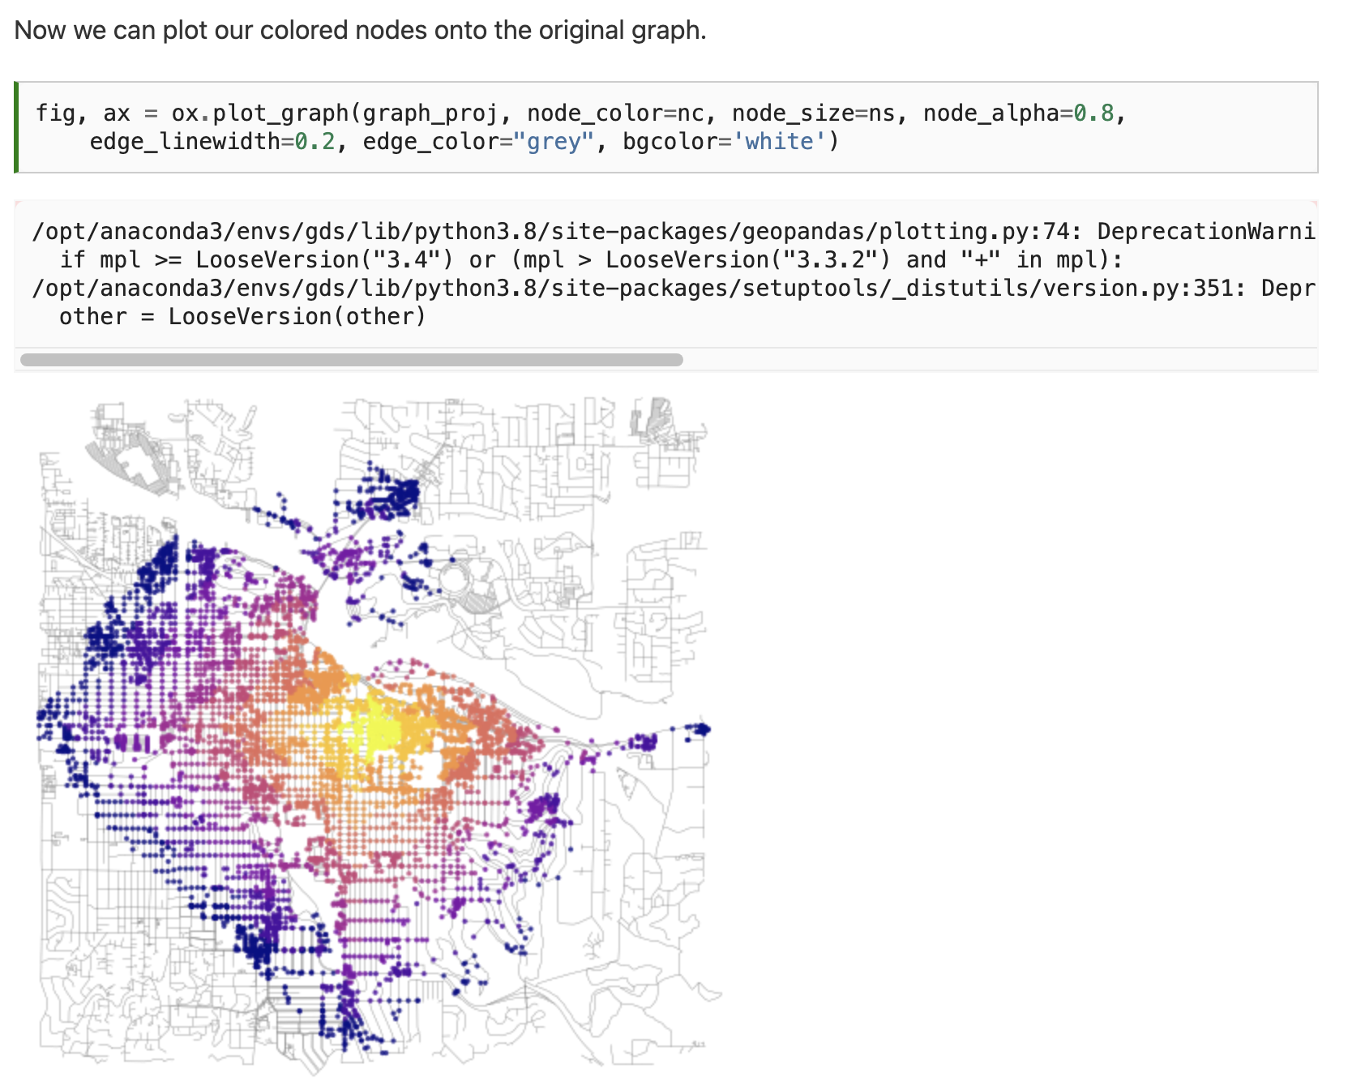
Notes:
This looks great but is of limited use since the buildings that we want to travel to are not necessarily associated with nodes. It would be more convenient to convert this data into polygons which we could use to intersect buildings (or points) of interest.

Slide 39
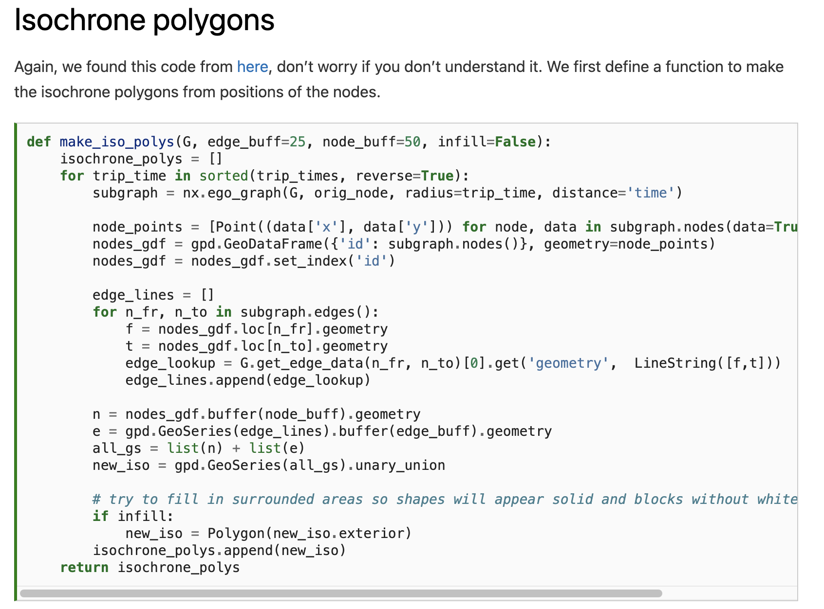
Notes:
This looks great but is of limited use since the buildings that we want to travel to are not necessarily associated with nodes. It would be more convenient to convert this data into polygons which we could use to intersect buildings (or points) of interest.

Slide 40
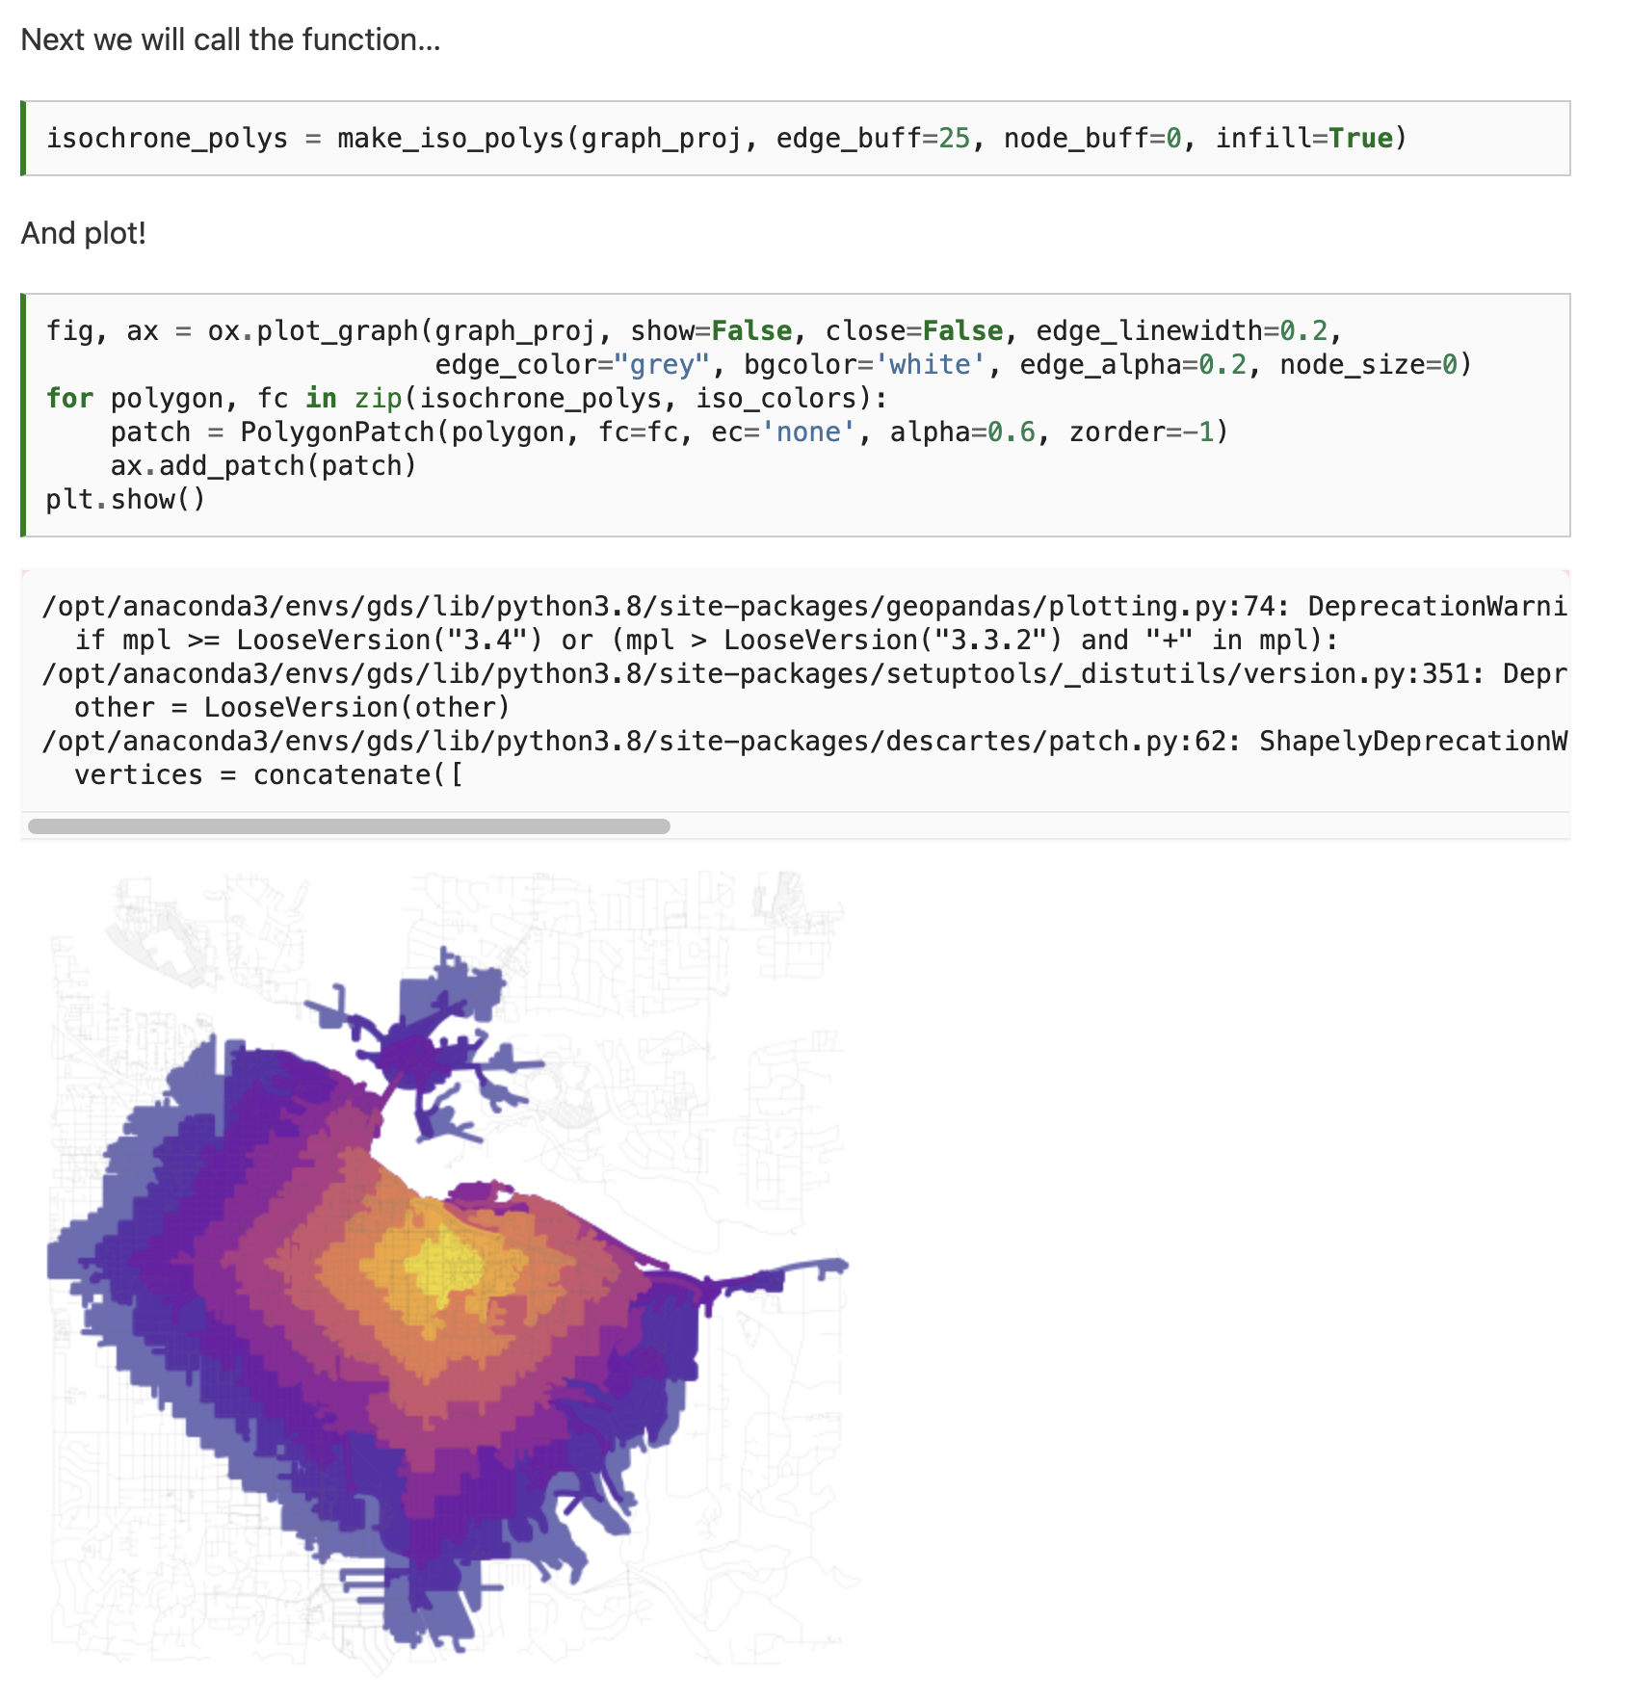
Notes:
This looks great but is of limited use since the buildings that we want to travel to are not necessarily associated with nodes. It would be more convenient to convert this data into polygons which we could use to intersect buildings (or points) of interest.

Slide 41
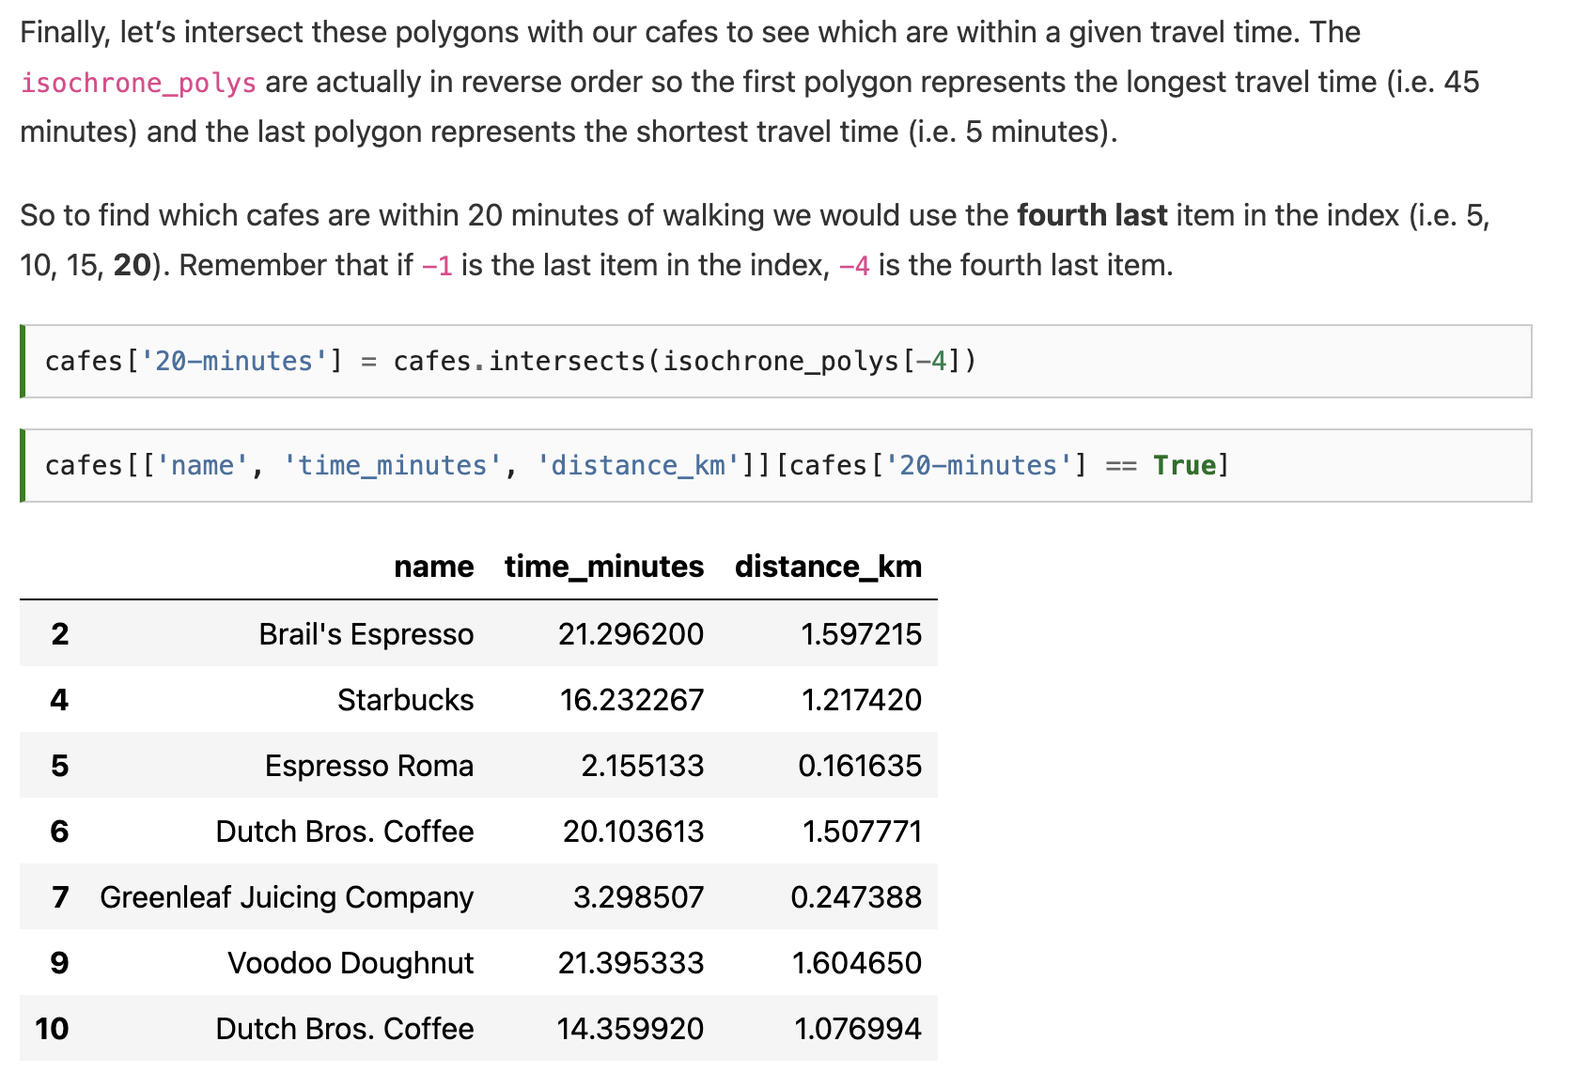
Notes:
This looks great but is of limited use since the buildings that we want to travel to are not necessarily associated with nodes. It would be more convenient to convert this data into polygons which we could use to intersect buildings (or points) of interest.

Slide 42
Notes:
This looks great but is of limited use since the buildings that we want to travel to are not necessarily associated with nodes. It would be more convenient to convert this data into polygons which we could use to intersect buildings (or points) of interest.

Slide 43
Next time: Gridded data analysis
Email: jryan4@uoregon.edu
Office: 163A Condon Hall
Office hours: Monday 15:00-16:00 and Tuesday 14:00-15:00

